Slide 1
Plan your own garden!
Make a copy of this slideshow to customize to your garden.
In the top left click
→ “File”
→ “Make a Copy”
→ “Entire Presentation”
This is also fitted to a 11 in by 8.5 in paper so feel free to print out your plans!
Made by Sofie Gmerek

Slide 2
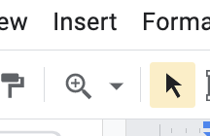
Measure and Area
Measure the length of your yard or area to redo in ft
Then use the following measurements and scales to form your area on the next slide by copy and pasting them and adjusting to your desired orientation. If things are too small use the zoom in on slides to help. Examples are at the end.
The scale is 10 px to 1 ft
1 ft by 1 ft
5 ft by 1 ft
10 ft by 1 ft
50 ft by 1 ft
5 ft by 5 ft
10 ft by 10 ft

Slide 3
Your Garden Area

Slide 4
2. Plants Planning
Next, plan out what plants you want and how much area they take up. I used values for coverage from the Santa Clara Valley Water resource https://scvwd.dropletportal.com/public/pdf/plant_list/full/ this is also a list of many drought tolerant and native plants. You can also look at plants on www.calscape.org
Once you’ve found plants you want, either write them down on the next slide or use a copy of this spreadsheet to keep track of the plants.
Don’t worry about the “Code” column for now, that comes later.

Slide 5
Plants list
Code | Plant | Latin name | Coverage | Quantity | Total Coverage

Slide 6
3. Placing the Plants
Now it is time to place the plants into your garden area. You can do this by copying and pasting your garden area slide and by using the coverage values and the below circle areas. Copy and paste the circles and place them in your area. You can label them by double clicking in the circle and typing in a code. I separated my garden into different areas so I used codes like A1, B1, B2, etc. I also used color coding by changing the colors of the circles for plants
Coverage:
1
2
3
5
7
Coverage:
10
20
30
50
Coverage:
70
100

Slide 7
Your Garden Area + Plants

Slide 8
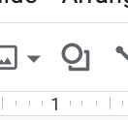
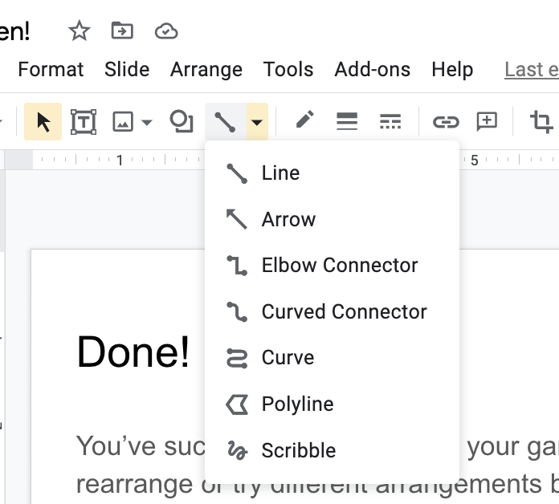
Done!
You’ve successfully planned out your garden. Feel free to adjust or rearrange or try different arrangements be copying the slide you made. You can also add in hardscape features like pathways with the area markers from the beginning or add in other features with shapes or lines like the scribble line. Have fun with your gardening adventure!

Slide 9
Example: My Garden
A6
A7
A
B
C
D
H
S
2
A3
A1
5
A4
A7
2
B3
2
2
2
5
2
2
H1
2
B1
2
5
2
4
C1
4
214.5 sq ft
4
H2
6
6
C3
H5
C3
4
H5
6
5
C3
4
B4
1
4
5
6
6
1
H5
H2
C2
5
4
4
4
6
6
6
5
5
H5
H5
2
2
2
71.5 sq ft
292.5 sq ft
2
2

Slide 10
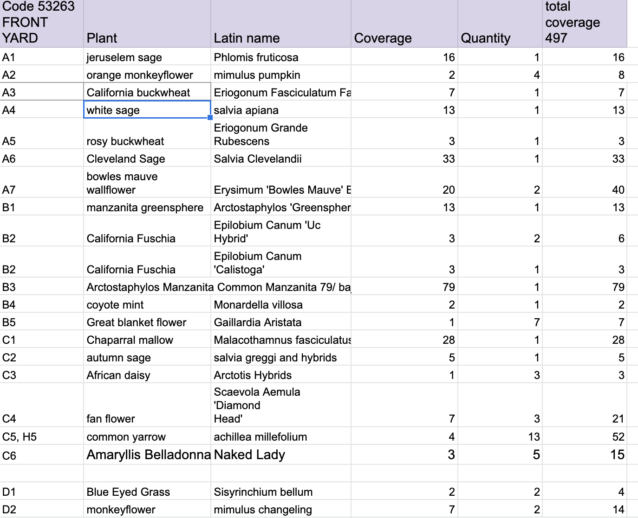
Example: My Plant List

